Slide 1
Big Data Platform

Slide 2
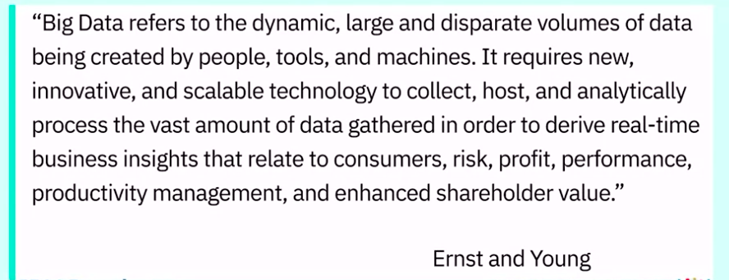
16. Foundation of Big Data

Slide 3
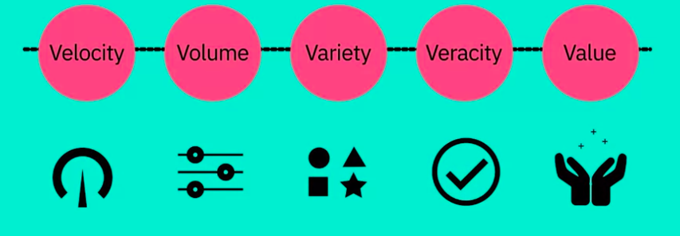
16. Foundation of Big Data - The V’s of Big Data
There is no one definition of Big Data, but there are certain elements that are common across the different definitions, such as velocity, volume, variety, veracity, and value.

Slide 4
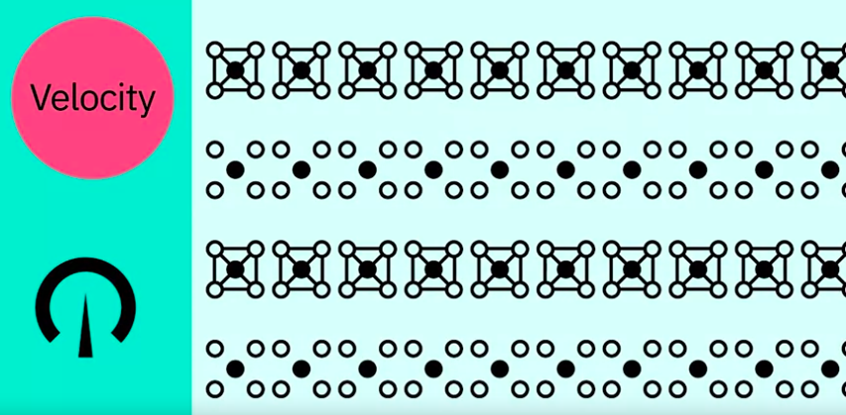
16. The V’s of Big Data - Velocity
Velocity is the speed at which data accumulates. Data is being generated extremely fast, in a process that never stops.
Near or real-time streaming, local, and cloud-based technologies can process information very quickly.

Slide 5
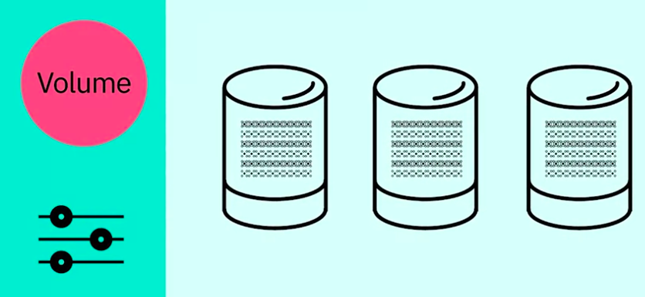
16. The V’s of Big Data - Volume
Volume is the scale of the data, or the increase in the amount of data stored

Slide 6
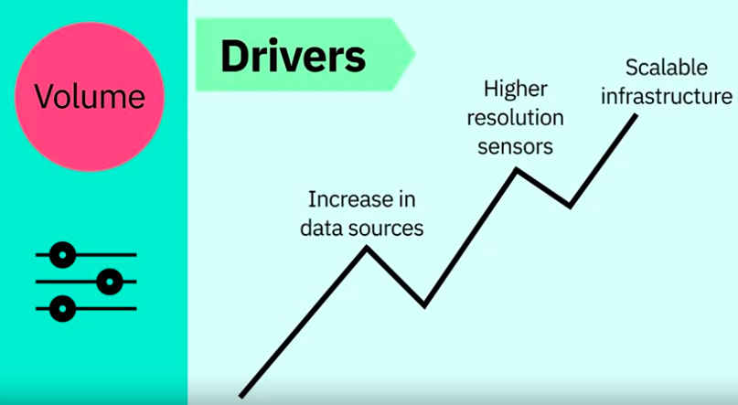
16. The V’s of Big Data - Volume

Slide 7
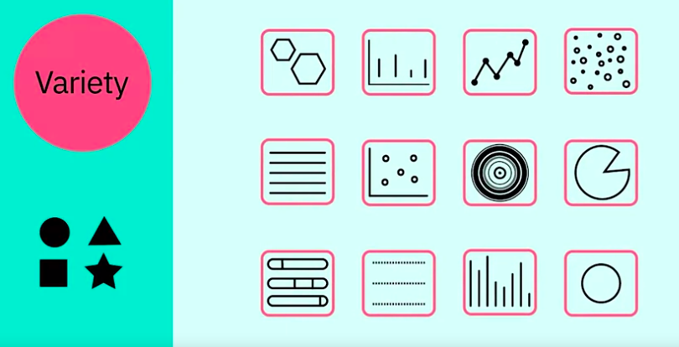
16. The V’s of Big Data - Variety
Structured- Row & Column
Semi-Sructured – email
Unstructured- blog posts,tweets,numbers,
videos,documents
Variety is the diversity of the data.

Slide 8
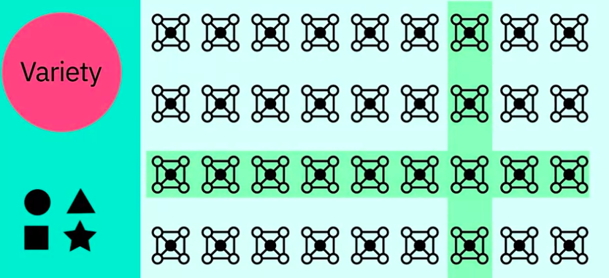
16. The V’s of Big Data - Variety - Structure Data
Structured data fits neatly into rows and columns, in relational databases

Slide 9

16. The V’s of Big Data - Variety - Unstructure Data
Unstructured data is not organized in a pre-defined way, like Tweets, blog posts, pictures, numbers, and video.

Slide 10
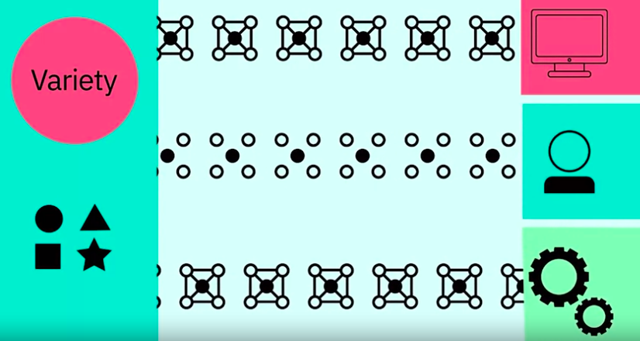
16. The V’s of Big Data - Variety
Variety also reflects that data comes from different sources, machines, people, and processes, both internal and external to organizations

Slide 11
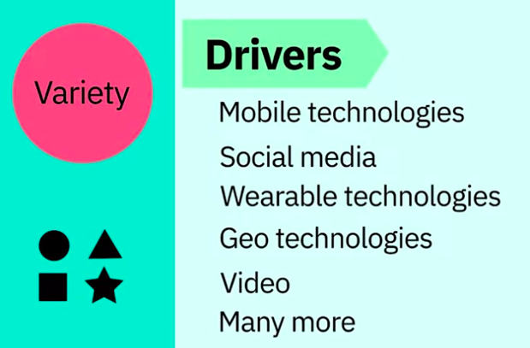
16. The V’s of Big Data - Variety

Slide 12

16. The V’s of Big Data - Veracity
Veracity is the quality and origin of data, and its conformity to facts and accuracy.

Slide 13
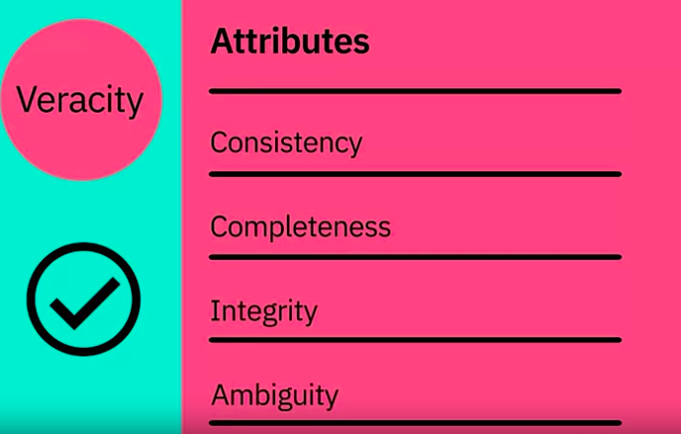
16. The V’s of Big Data - Veracity - Attributes

Slide 14
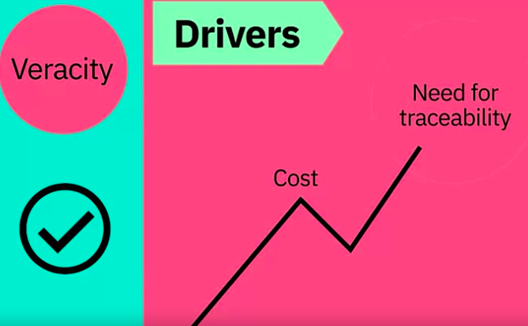
16. The V’s of Big Data - Veracity
Truy xuat nguon goc

Slide 15

16. The V’s of Big Data - Veracity
With the large amount of data available, the debate rages on about the accuracy of data in the digital era. Is the information real, or is it false?

Slide 16

16. The V’s of Big Data - Value
Value is our ability and need to turn data into value.
Value isn't just profit. It may have medical or social benefits, as well as customer, employee, or personal satisfaction.

Slide 17
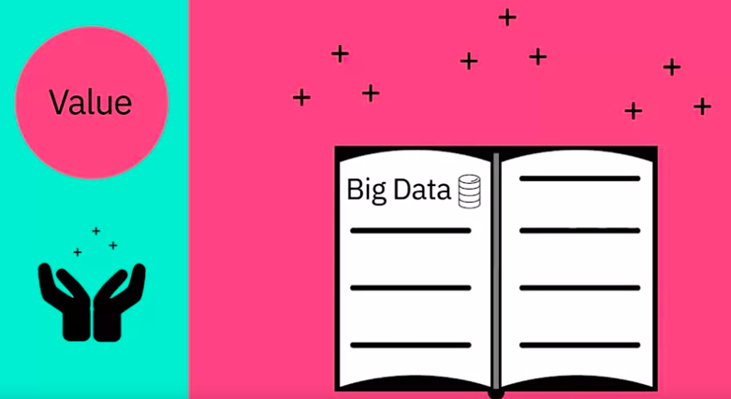
16. Big Data Application
The main reason that people invest time to understand Big Data is to derive value from it.

Slide 18
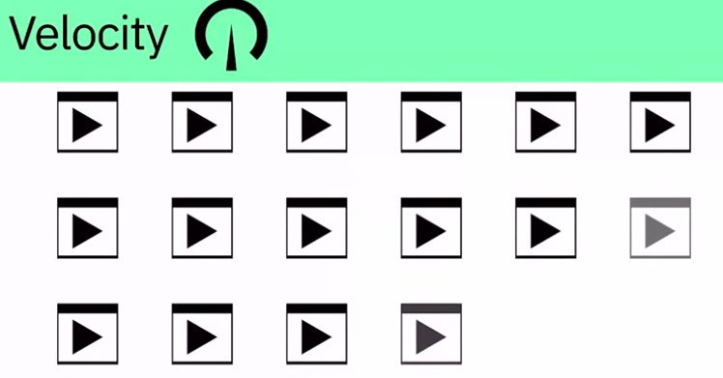
16. Big Data Application - Velocity
Every 60 seconds, hours of footage are uploaded to YouTube which is generating data. Think about how quickly data accumulates over hours, days, and years

Slide 19
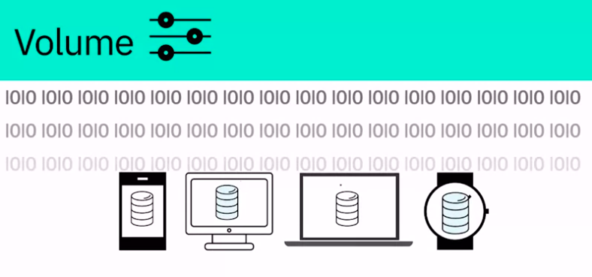
16. Big Data Application - Volume
The world population is approximately seven billion people and the vast majority are now using digital devices; mobile phones, desktop and laptop computers, wearable devices, and so on. These devices all generate, capture, and store data -- approximately 2.5 quintillion bytes every day. That's the equivalent of 10 million Blu-ray DVD's.

Slide 20
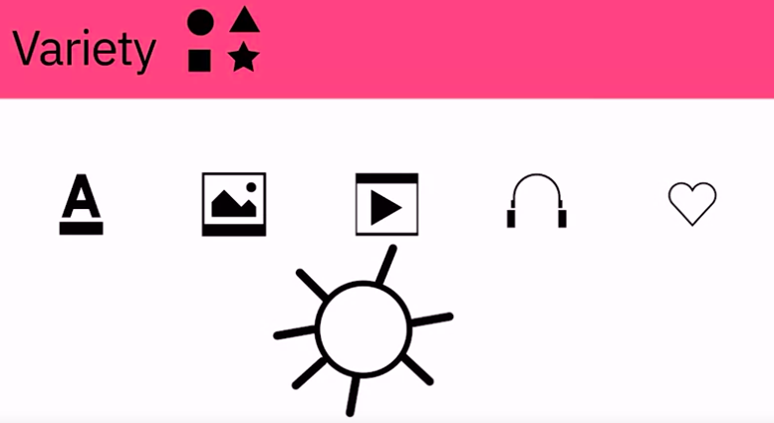
16. Big Data Application - Variety
Let's think about the different types of data; text, pictures, film, sound, health data from wearable devices, and many different types of data from devices connected to the Internet of Things

Slide 21
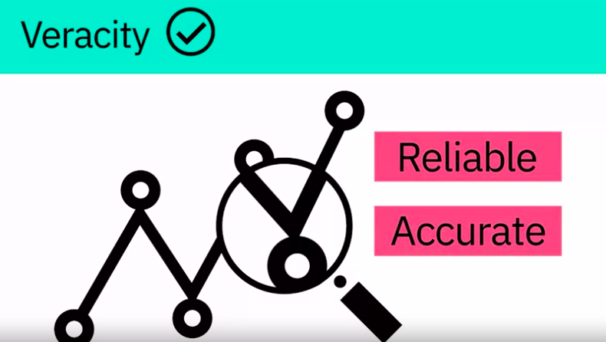
16. Big Data Application - Veracity
80% of data is considered to be unstructured and we must devise ways to produce reliable and accurate insights. The data must be categorized, analyzed, and visualized

Slide 22
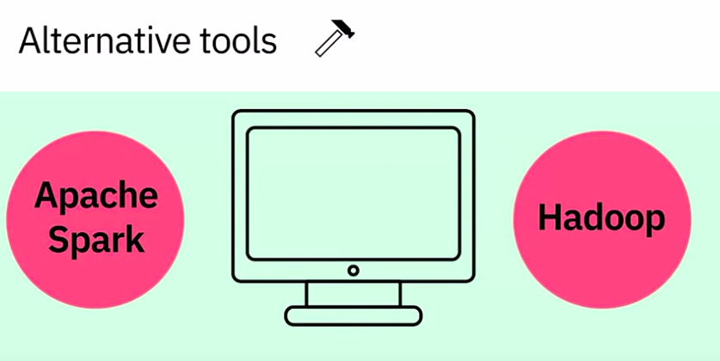
16. Tools
Big Data and cope with the challenges that these massive data sets present. The scale of the data being collected means that it’s not feasible to use conventional data analysis tools. However, alternative tools that leverage distributed computing power can overcome this problem. Tools such as Apache Spark, Hadoop and its ecosystem provide ways to extract, load, analyze, and process the data across distributed compute resources, providing new insights and knowledge.

Slide 23
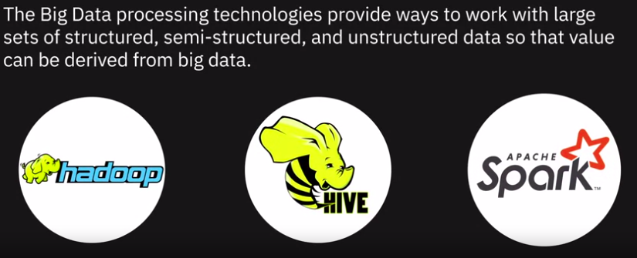
17. Big Data Processing Tools
Talk about three open source technologies and the role they play in big data analytics.

Slide 24
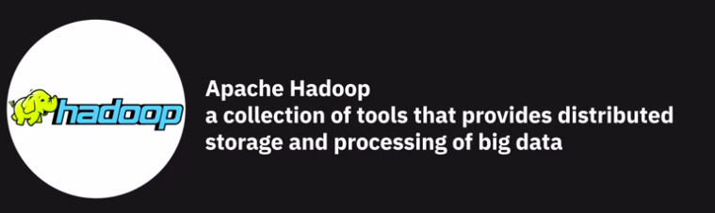


17. Big Data Processing Tools

Slide 25
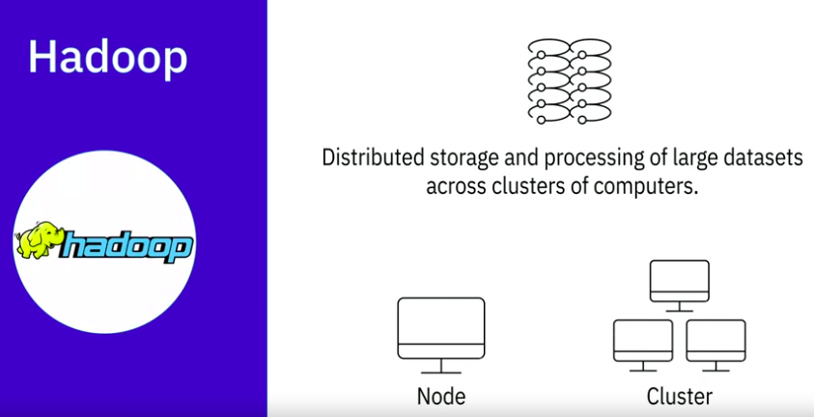
17. Big Data Processing Tools - Hadoop
Hadoop, a java-based open-source framework, allows distributed storage and processing of large datasets across clusters of computers

Slide 26
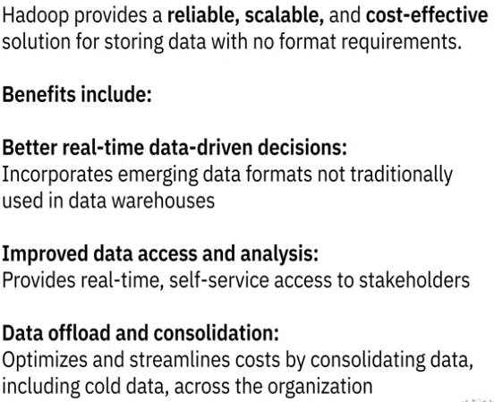
17. Big Data Processing Tools - Hadoop - Benefits
Incorporate emerging data formats, such as streaming audio, video, social media sentiment, and clickstream data, along with structured, semi-structured, and unstructured data not traditionally used in a data warehouse.

Slide 27
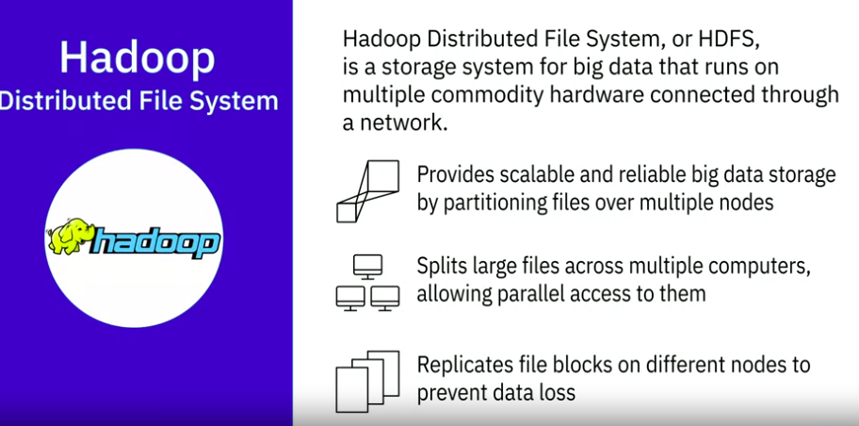
17. Big Data Processing Tools - Hadoop - HDFS

Slide 28
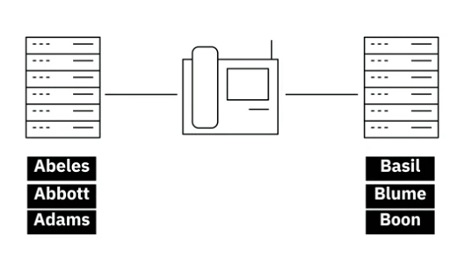
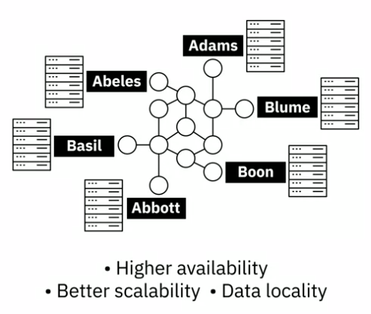
17. Big Data Processing Tools - Hadoop - HDFS example
Consider a file that includes phone numbers for everyone in the United States; the numbers for people with last name starting with A might be stored on server 1, B on server 2, and so on
With Hadoop, pieces of this phonebook would be stored across the cluster.
To reconstruct the entire phonebook, your program would need the blocks from every server in the cluster.
HDFS also replicates these smaller pieces onto two additional servers by default, ensuring availability when a server fails, In addition to higher availability, this offers multiple benefits. It allows the Hadoop cluster to break up work into smaller chunks and run those jobs on all servers in the cluster for better scalability.

Slide 29
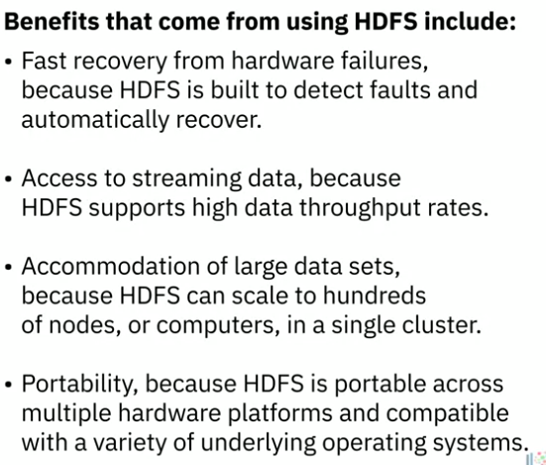
17. Big Data Processing Tools - Hadoop - Benefits of HDFS

Slide 30
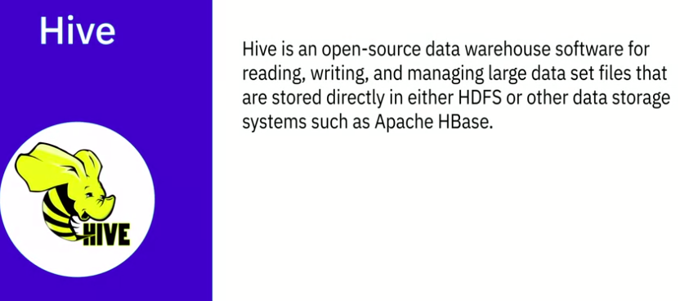
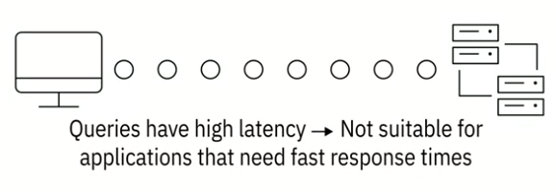
17. Big Data Processing Tools - Hive

Slide 31
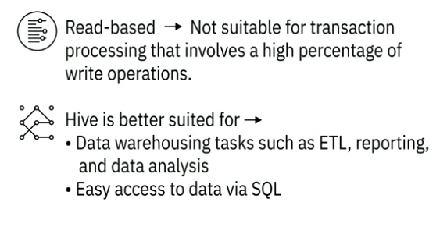
17. Big Data Processing Tools - Hive

Slide 32
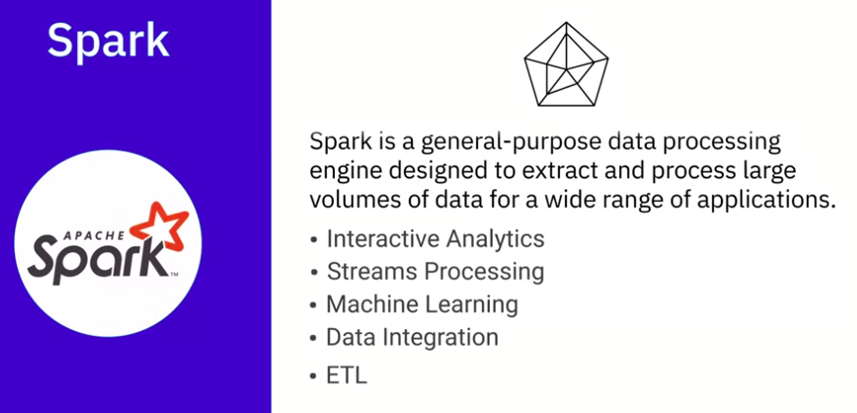
17. Big Data Processing Tools - Spark

Slide 33
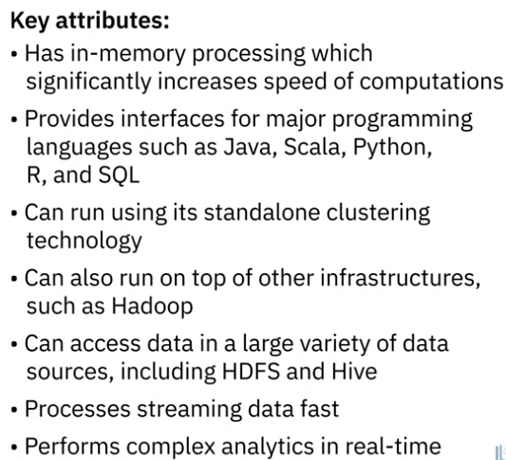
17. Big Data Processing Tools - Spark

Slide 34

18. Viewpoint: Impact of Big Data on Data Engineering

Slide 35
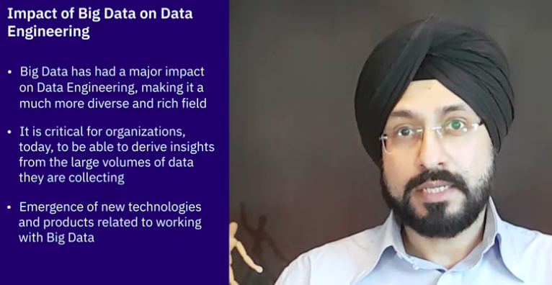
18. Viewpoint: Impact of Big Data on Data Engineering

Slide 36

18. Viewpoint: Impact of Big Data on Data Engineering

Slide 37
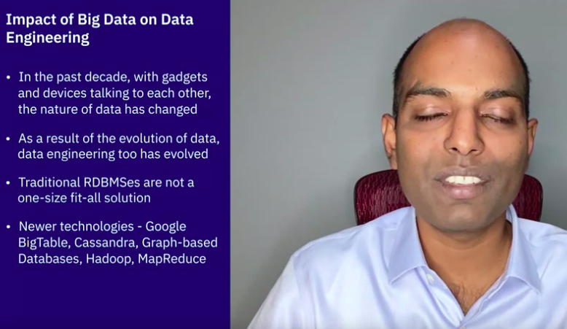
18. Viewpoint: Impact of Big Data on Data Engineering

Slide 38
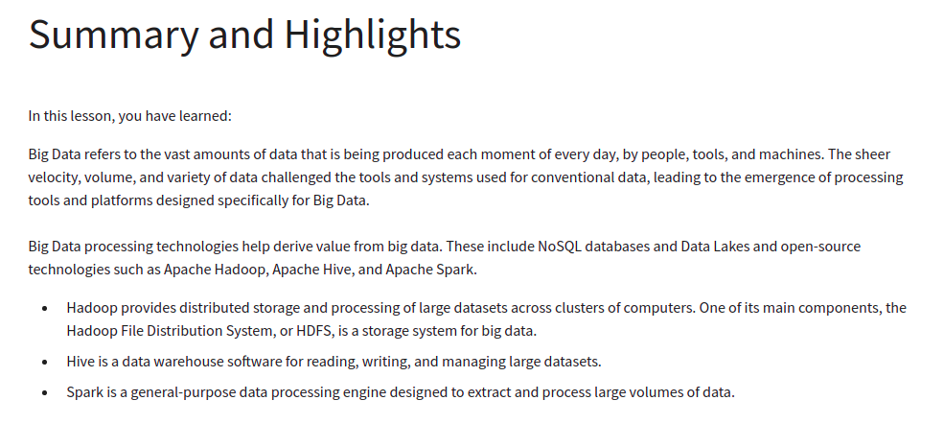
Recap

Slide 39
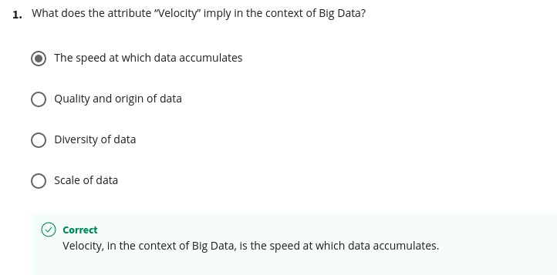
Quizz

Slide 40
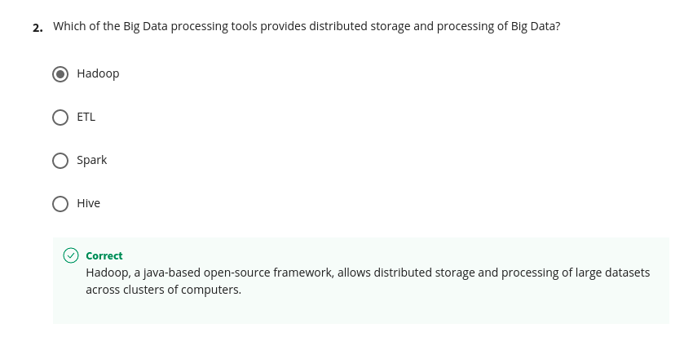
Quizz

Slide 41
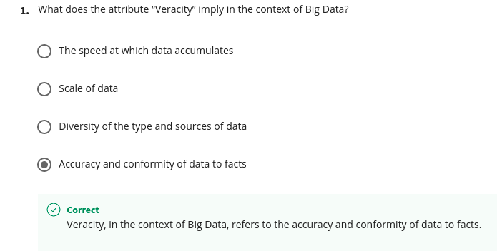
Quizz

Slide 42
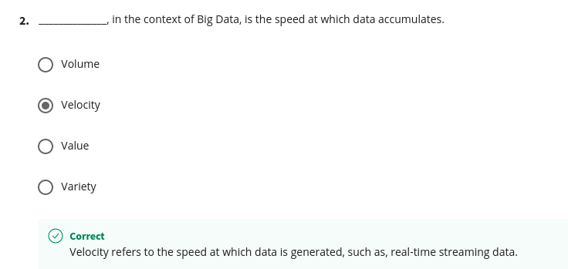
Quizz

Slide 43
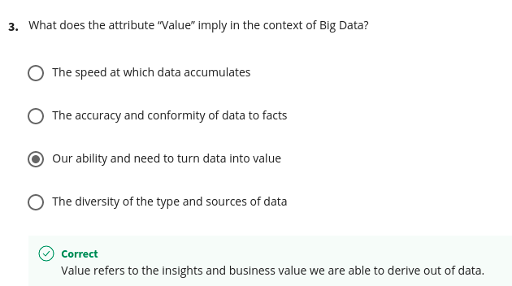
Quizz

Slide 44
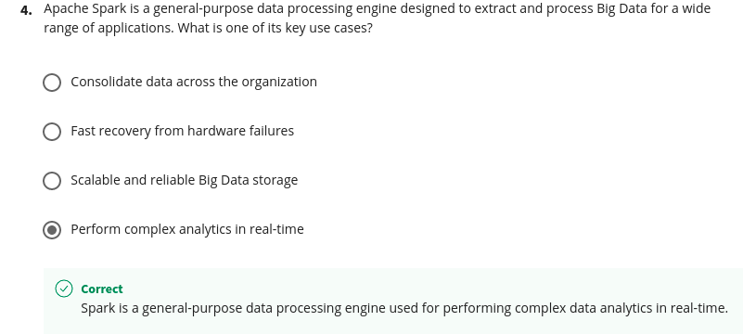
Quizz

Slide 45
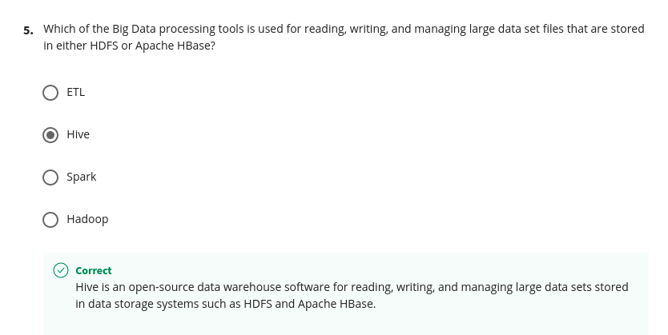
Quizz

